Slide 1


Department of Electrical and Electrical Engineering
Academic Year (2022 – 2023)
III year – V semester
Minor Project 3
Final Review
SMART PLUG WITH ANDROID INTERFACE
Batch members
Guided by
Dr C Kumar
The Head of the Department
Department of EEE
MKCE
Bhoopesh T (20BEE4006)
Dharunish AP (20BEE4015)
Deenadhayalan M (20BEE4304)

Slide 2
Contents
Abstract
Introduction
Hardware requirements
Block diagram
Description of the block diagram
Circuit diagram
Conclusion

Slide 3
Abstract
This project implements a Smart Plug project which can measure the Power, Current, Voltage of any load connected to it.
The Android phone interface can be used to read the values from the plug and also controls its ON/OFF.
The values are also regularly sent to the Android device for monitoring.
This project will outline the method to write and build the GR Peach program, and also writing the Android Application using the cloud application called App Inventor.

Slide 4
Introduction
The system is designed such that smart sockets wirelessly provide the necessary data to a central controller. Then, the system analyses the data to generate control commands to turn the devices attached to the smart socket on or off.
Experimental results show that the proposed smart socket can correctly read the power consumption of wirelessly connected devices from up to without loss of data.
The central controller can effectively control multiple sockets on the basis of a scheduled user program code. Thus, the proposed smart socket system can be fully utilized in a home energy management system with a proper scheduling algorithm.

Slide 5
Hardware requirements
Arduino Mother Board
Temperature sensor
Relay driver
Power plug
Bluetooth

Slide 6
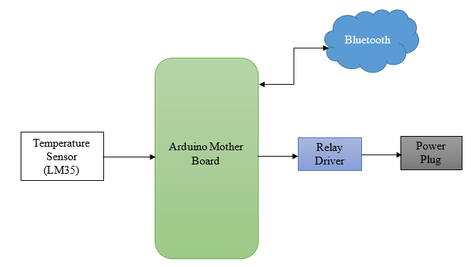
Block diagram

Slide 7
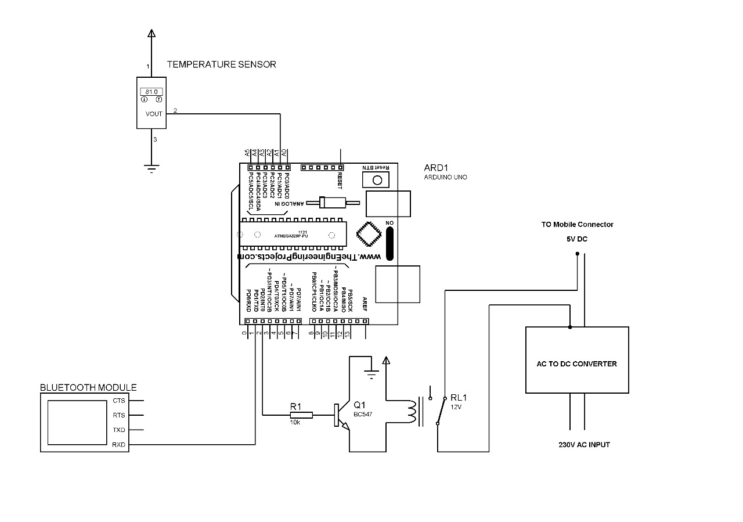
Circuit diagram

Slide 8
Arduino mother board
Arduino is an open source electronics platform accompanied with a hardware and software to design, develop and test complex electronics prototypes and products.
The hardware consists of a microcontroller with other electronic components which can be programmed using the software to do almost any task.
The simplicity of the Arduino language makes it very easy for almost everyone who has an interest in electronics to write programs without the understanding of complex algorithms or codes.

Slide 9
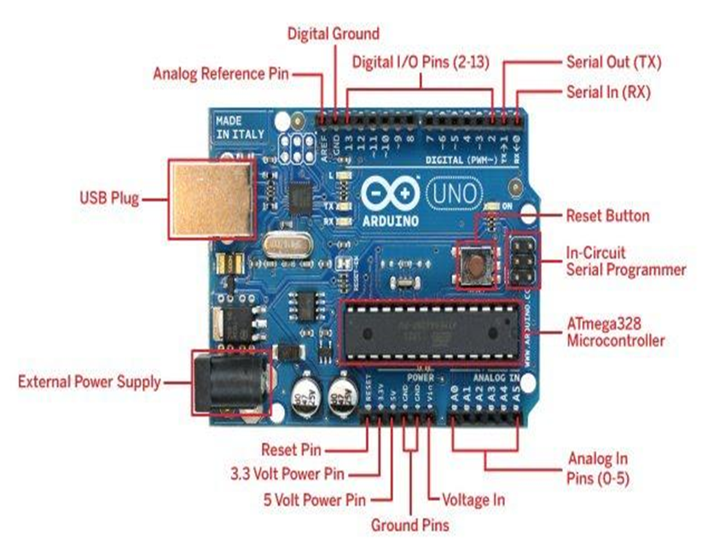
Arduino mother board

Slide 10
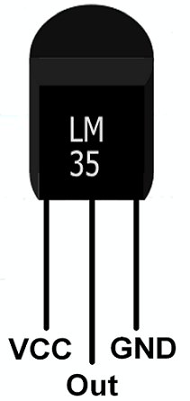
Temperature sensor (LM35)
LM35 is a temperature measuring device having an analog output voltage proportional to the temperature.
It provides output voltage in Centigrade (Celsius). It does not require any external calibration circuitry.
The sensitivity of LM35 is 10 mV/degree Celsius. As temperature increases, output voltage also increases. Example: 250 mV means 25°C.
It is a 3-terminal sensor used to measure surrounding temperature ranging from -55 °C to 150 °C.
LM35 gives temperature output which is more precise than thermistor output.

Slide 11
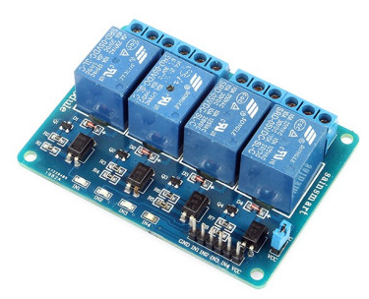
Relay driver
The Relay Driver is a logic module which provides high level system control functions such as high/low voltage alarms, load control and generator start. The product controls four independent relay driver outputs by reading digital data inputs from Morningstar’s TriStar controller or by reading battery voltage when used in systems with other controllers.
A relay allows circuits to be switched by electrical equipment: for example, a timer circuit with a relay could switch power at a preset time. For many years relays were the standard method of controlling industrial electronic systems.

Slide 12
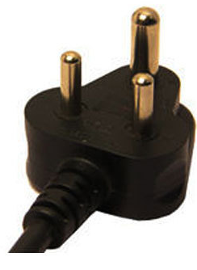
Power plug
AC power plugs and sockets connect electric equipment to the alternating current (AC) mains electricity power supply in buildings and at other sites.
Electrical plugs and sockets differ from one another in voltage and current rating, shape, size, and connector type.

Slide 13
Bluetooth
Bluetooth is a short-range wireless technology standard that is used for exchanging data between fixed and mobile devices over short distances and building personal area networks (PANs).
It employs UHF radio waves in the ISM bands, from 2.402 GHz to 2.48 GHz.[3] It is mainly used as an alternative to wire connections, to exchange files between nearby portable devices and connect cell phones and music players with wireless headphones.
In the most widely used mode, transmission power is limited to 2.5 milliwatts, giving it a very short range of up to 10 metres

Slide 14
Conclusion
The simple algorithm is implemented for monitoring and controlling the energy consumption. In this work, it is possible to use the temperature sensor to implement the wireless communication between the smart plugs and the embedded base server for monitoring and controlling the electrical power energy usage.
The basic idea behind this program is to use the many capabilities of the Mobile devices like Colour display, Bluetooth, Wi-Fi etc. to act as an interface to collect data from external devices and manipulate them. In this case the external device is connected to the Android Device running the Application manipulates and displays the data. This project also introduced the use of App Inventor to write simple programs for Android devices using blocks.

Slide 15


